Slide 1

4-BIT UNIVERSAL SHIFT REGISTER
Design & Simulation Using Logic Gates
K Aditya, Nanla Pranav, Goutham Kandula, Sariday Ganesh Sri Krishna
Subject: DDCA (Digital Design & Computer Architecture)
Lecturer: Professor Karthik
Department: Electronics & Communication Engineering
College: KLH, Bachupally
Academic Year: 2026-2027

Slide 2

Shift Registers: Foundation of Digital Data Flow
Shift registers are fundamental components in digital electronics, enabling sequential data storage and manipulation. Their evolution from basic serial-in/serial-out structures to advanced universal designs has been pivotal. Today, they are critical for efficient data transfer, arithmetic operations within CPUs, and complex signal processing, forming the backbone of modern computing architecture.

Slide 3

Problem Statement: Limitations of Traditional Shift Registers
Unidirectional Data Flow
Basic shift registers are limited to single-direction data movement, severely restricting their applicability in complex data processing tasks.
No Parallel Loading
The sequential nature of data loading in basic designs prevents efficient, simultaneous input of multiple data bits, slowing down operations.
Lack of Flexibility
Rigid design prevents dynamic manipulation of data and combination of functions, hindering adaptability to diverse circuit requirements.
Fragmented Solutions
The current approach requires separate circuits for different operations, leading to increased complexity and component count in system design.

Slide 4
Project Objectives: 4-bit Universal Shift Register
Design & Implementation
Bidirectional Shifting
Parallel Loading
Craft a 4-bit universal shift register using fundamental logic gates, ensuring robust and efficient operation.
Incorporate capabilities for both left and right data shifting, controlled by selection inputs.
Integrate a parallel data load feature to efficiently input and update the register's contents.
Verification & Testing
Practical Applications
Validate the design's functionality through comprehensive truth tables and rigorous simulation.
Illustrate real-world utility in data conversion, signal processing, and sequence generation.

Slide 5

Literature Survey: Shift Register Designs
Our comprehensive literature review covered fundamental concepts and advanced optimizations in shift register technology.
Existing Designs
Reviewed basic, bidirectional, and universal shift register architectures.
Implementation Analysis
Compared discrete logic gates against modern integrated circuit solutions.
Multiplexer Architectures
Detailed comparison of various multiplexer configurations in register design.
Design Optimization
Extensive study of IEEE papers focusing on register design and performance optimization.

Slide 6

Universal Shift Register Design
Multiplexers
Shift & Load
Four 4:1 MUXes selecting inputs per mode
Hold, right/left shift, and parallel load
D Flip-Flops
Mode Select
Four edge-triggered D flip-flops in series
Two select lines S1, S0 choose operation
This design combines 4 D flip-flops with 4 multiplexers, controlled by two select lines (S1, S0). This enables essential operations including hold, right shift, left shift, and parallel load. Synchronous clocking ensures predictable timing and reliable data manipulation across all modes.

Slide 7

What Is A Universal Shift Register?
Store
Shift ←→
Holds binary data across clock cycles
Bidirectional left & right shifting
Load
Parallel data input capability

Slide 8

Core Architecture
4-bit register path with one multiplexer feeding each flip-flop.
1
Building Blocks
4 D Flip-Flops
One per bit — store state
3
Shared S1, S0
Common select lines control all MUXes
2
4 × 4:1 MUX
Select input per flip-flop

Slide 9
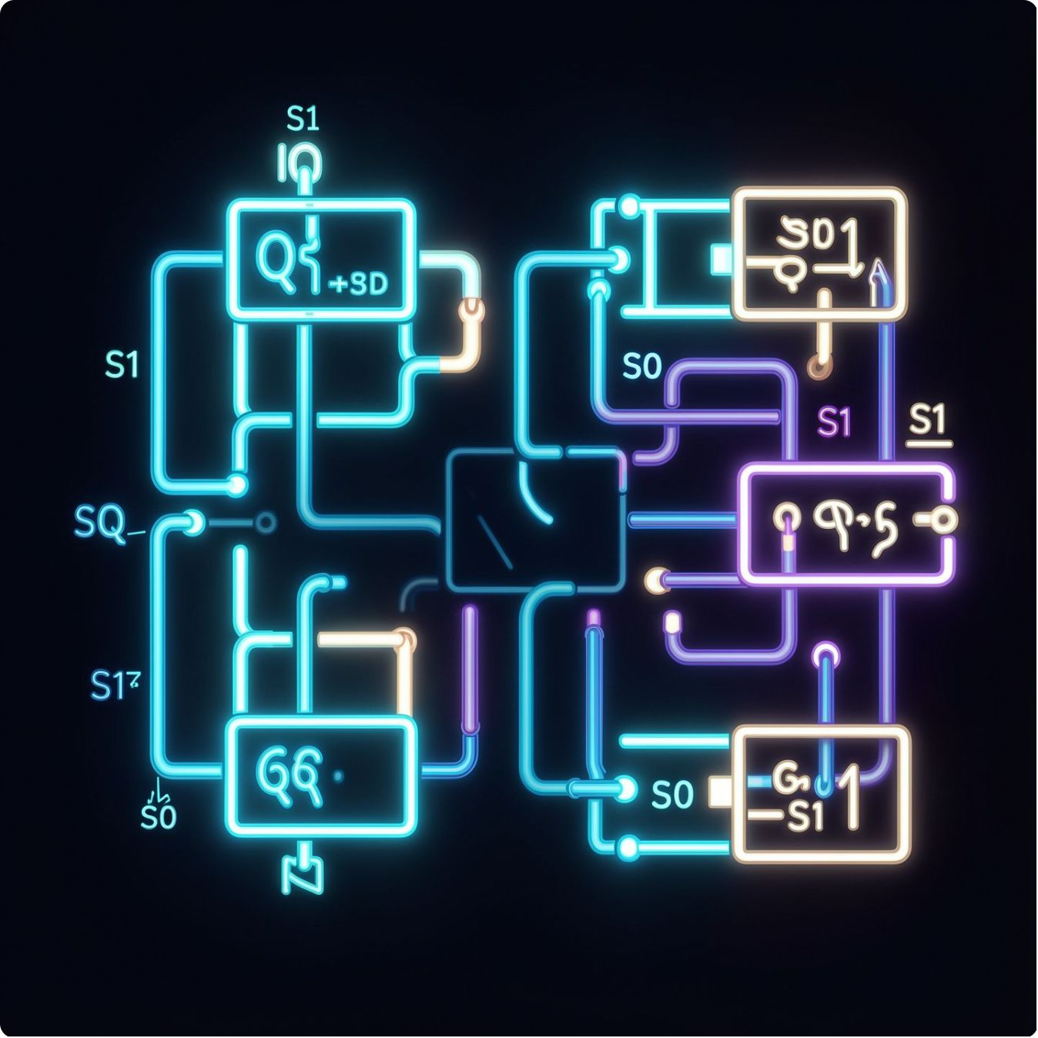
Multiplexer Input Connections
Input 0
1
Feedback — hold data
Input 1
2
Previous flip-flop — right shift
Input 2
3
Next flip-flop — left shift
Input 3
4
External — parallel load

Slide 10
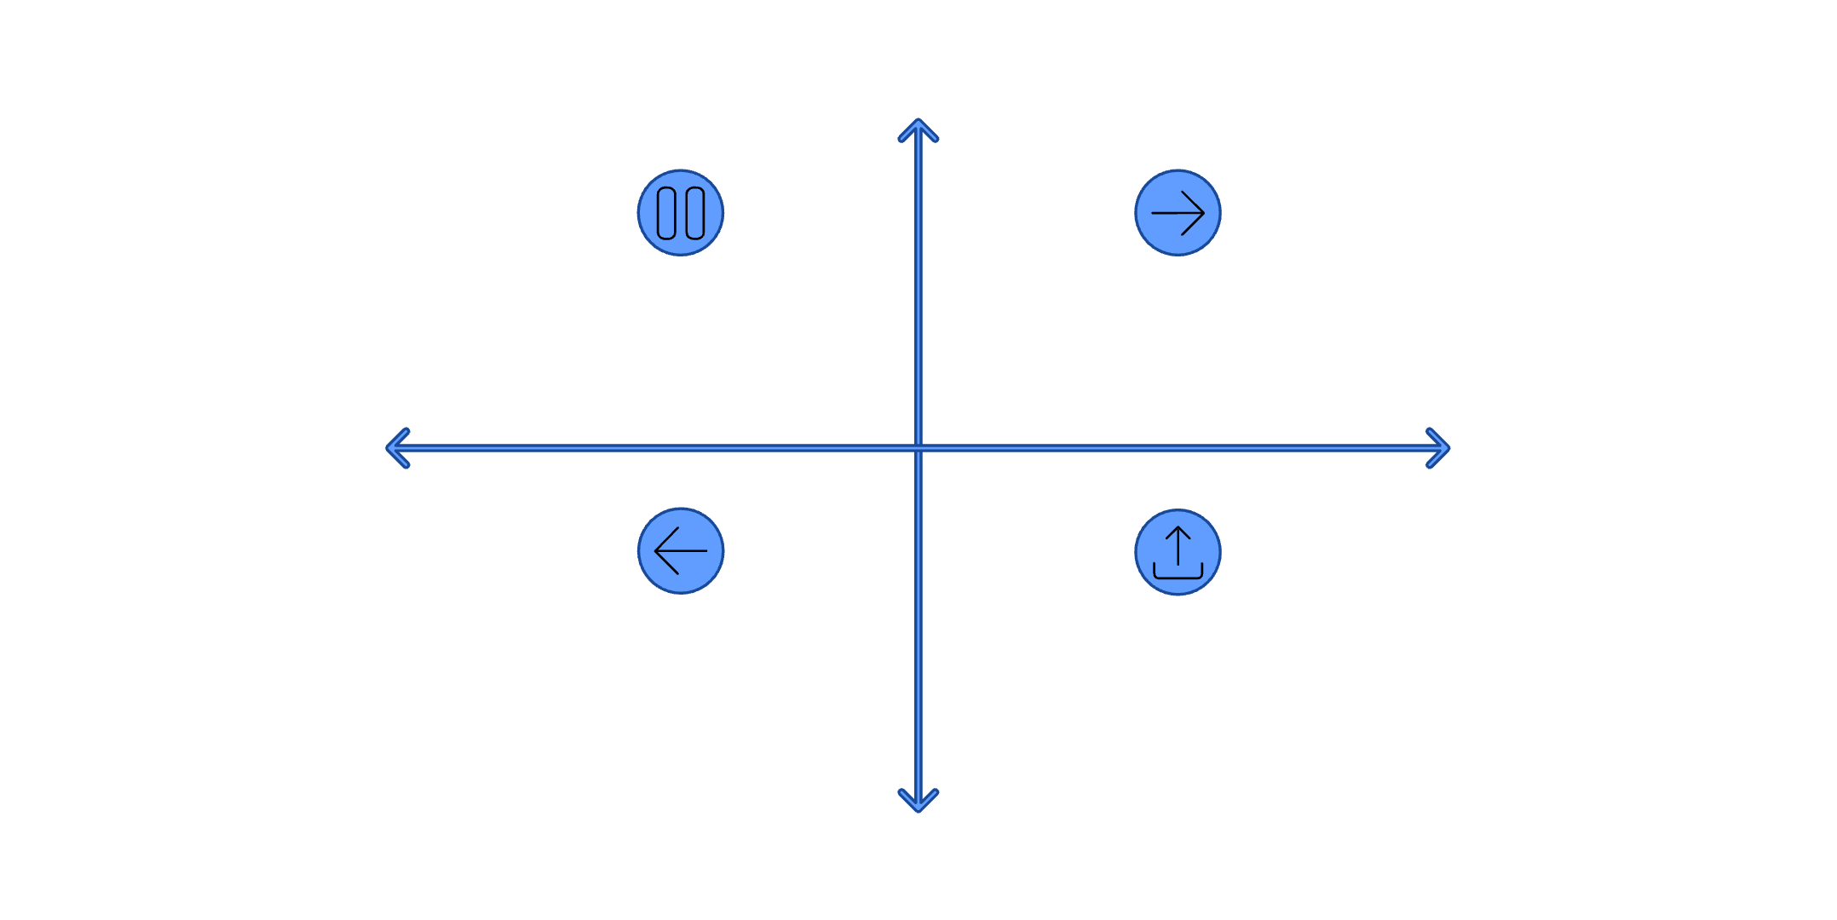
Operating Modes
Select Line Logic
High (S1=1)
S1=0, S0=0
No Change
Hold — S1=0 S0=0 (No change)
Shift Right — S1=0 S0=1
S1=0, S0=1
Left (S0=0)
Right (S0=1)
Shift Right
S1=1, S0=0
Shift Left — S1=1 S0=0
Parallel Load — S1=1 S0=1
Shift Left
Low (S1=0)
S1=1, S0=1
Parallel Load

Slide 11

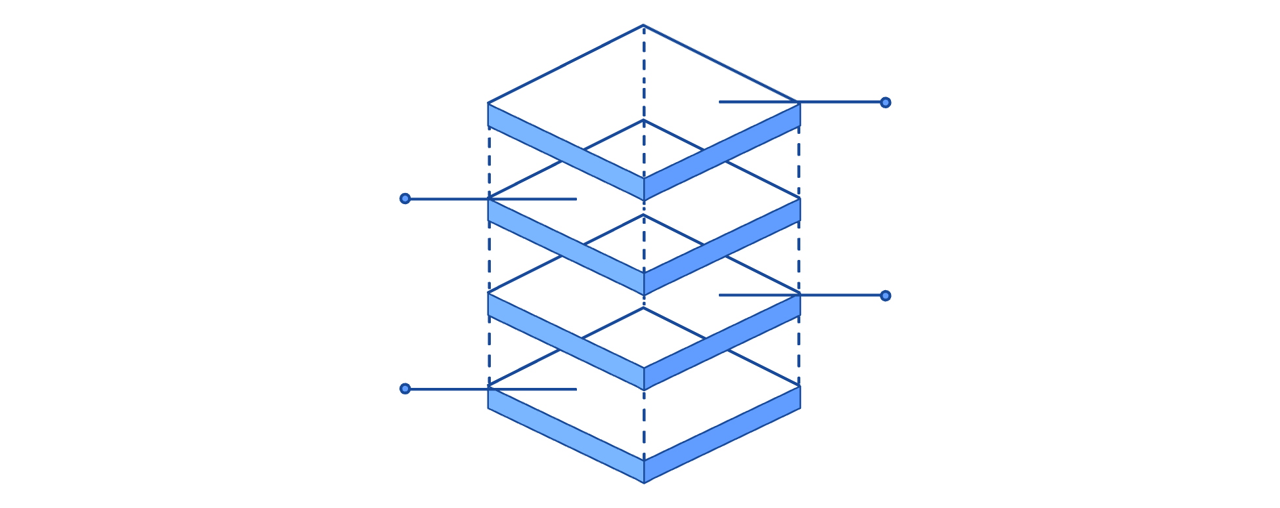
Logic Gate Implementation
Multiplexer logic uses AND gates to mask each input, NOT gates to generate complementary select signals, and a final OR gate to combine the selected path into the output.
AND Gates
Mask select signals per input line
OR Gates
Combine selected paths into MUX output
NOT Gates
Invert select lines for complementary control
Multiplexer Gate Diagram
Y output
OR combine
AND gating with S1, S0 and their complements
I0, I1, I2, I3

Slide 12
Key Advantages
Bidirectional
Parallel I/O
Synchronous
Shift left or right in a single circuit
Load or read all 4 bits simultaneously
Predictable, clock-driven timing throughout

Slide 13




Applications
Data Conversion
Serial ↔ Parallel
CPU Memory
Registers inside processors
Signal Processing
Digital filters & pipelines

Slide 14
Results & Discussion
Our 4-bit universal shift register design was rigorously tested through comprehensive simulation, confirming its functionality across all operating modes. This section presents the truth tables, key simulation outputs, and discusses the overall performance and verification against our design objectives.
Operating Modes Truth Table
S1 | S0 | Mode | Operation
0 | 0 | Hold | No change in register contents
0 | 1 | Shift Right | Data shifts from Q0 → Q1 → Q2 → Q3
1 | 0 | Shift Left | Data shifts from Q3 → Q2 → Q1 → Q0
1 | 1 | Parallel Load | External data inputs (D0-D3) loaded simultaneously

Slide 15
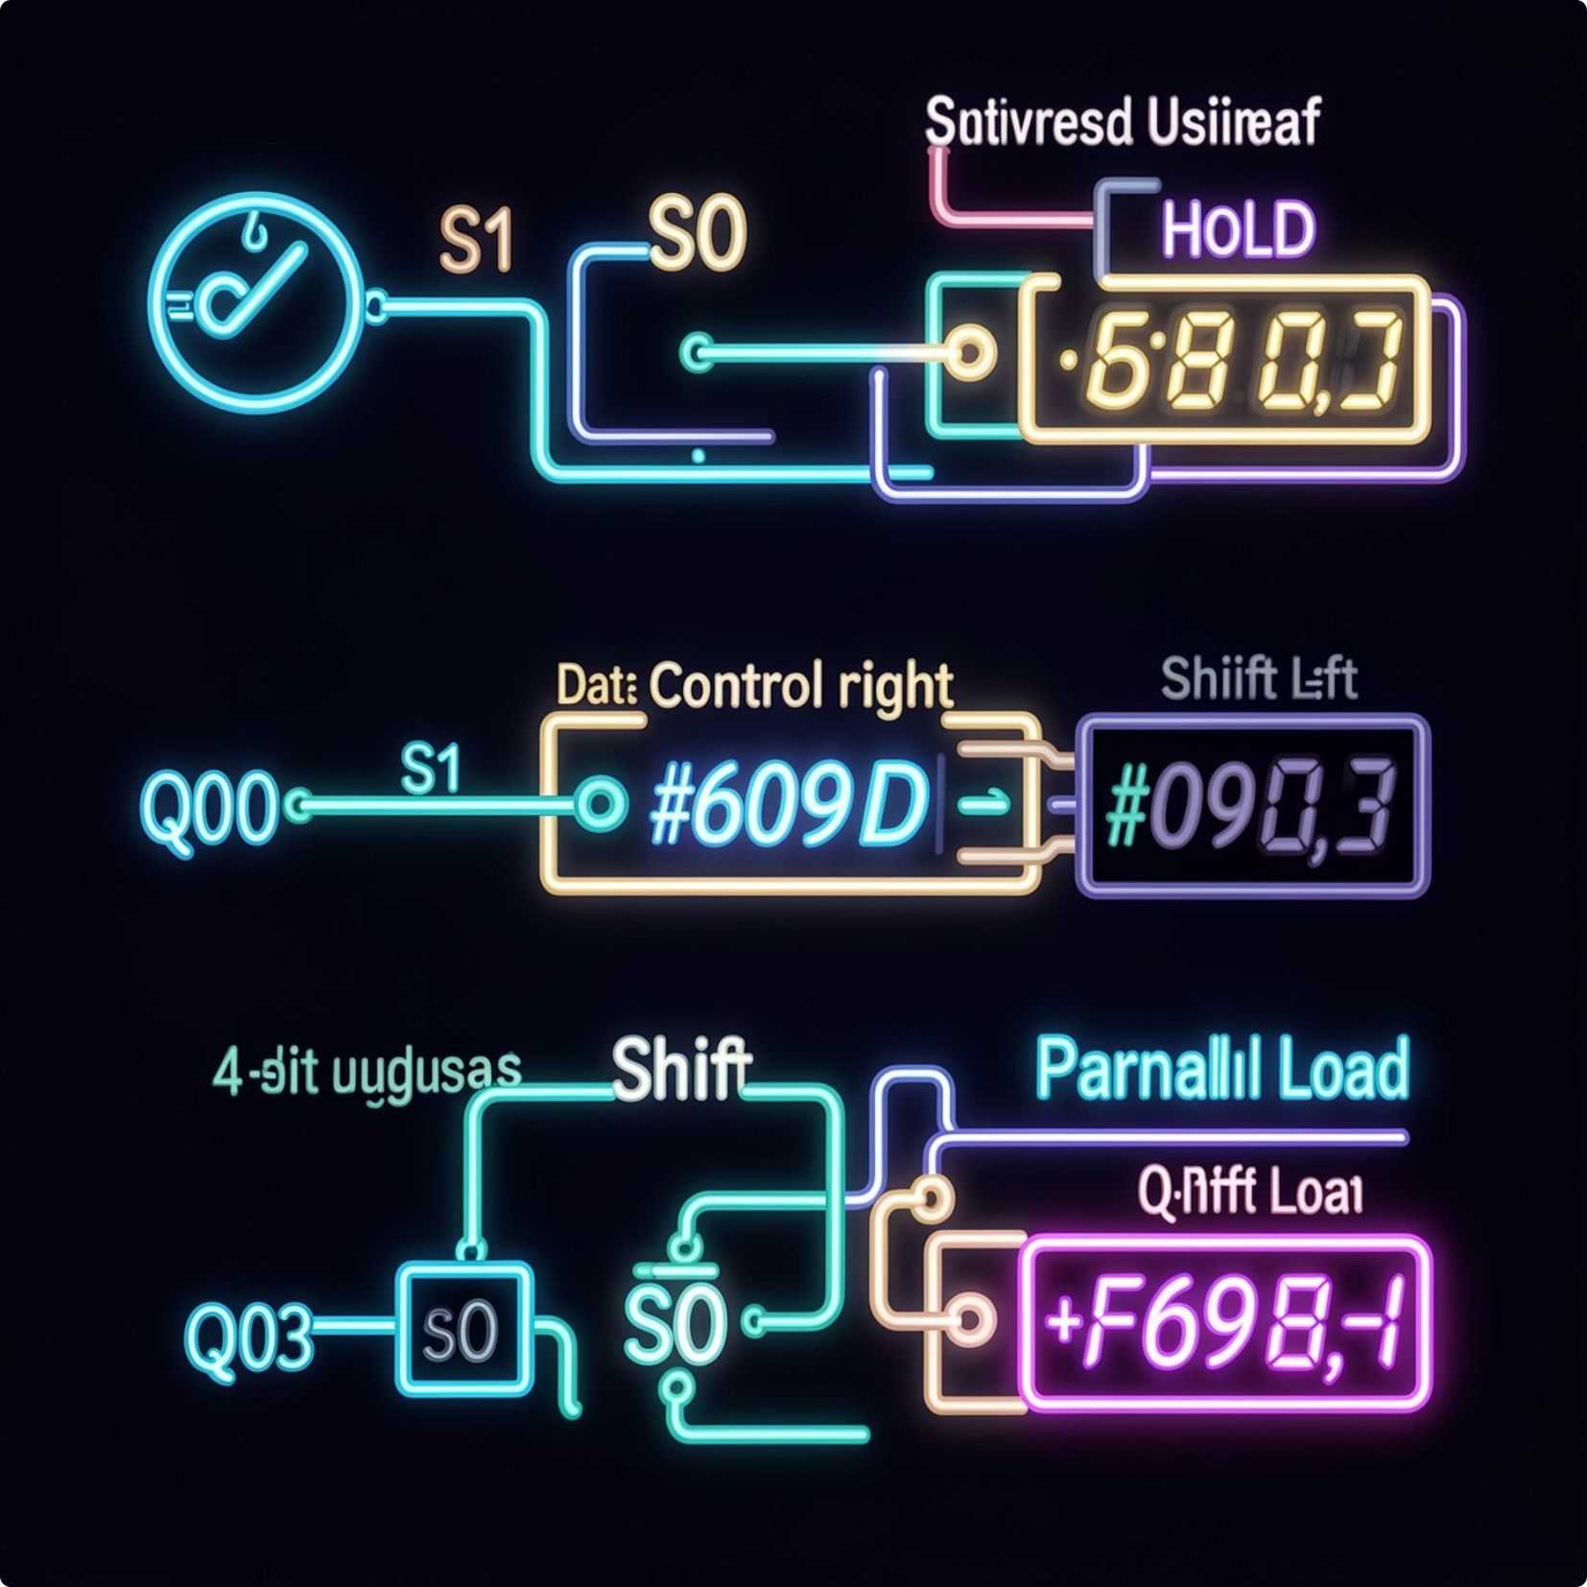


Simulation Timing Diagram
Circuit Output Verification
The timing diagram visually confirms the register's response to clock edges and control signal changes, demonstrating correct data propagation for each mode. For instance, the 'Shift Right' segment clearly shows data bits moving sequentially from left to right with each clock pulse.
Detailed circuit output screenshots capture the internal state of the flip-flops during various operations. This specific image illustrates a 'Shift Right' operation, where an initial data input (e.g., 1011) progresses bit by bit through the register, confirming the precise data flow as designed.
Performance metrics and verification: The design exhibits stable synchronous operation with minimal propagation delay. All functionalities align perfectly with the truth table and design specifications, confirming robustness and reliability for diverse digital applications.

Slide 16

Conclusion: A Universal Achievement
Our project successfully culminated in the design and simulation of a functional 4-bit universal shift register, meeting all defined objectives.
Robust Design & Simulation
Objectives Fully Met
Successfully designed and rigorously simulated a 4-bit universal shift register using fundamental logic gates.
Achieved all project goals, including bidirectional shifting, parallel loading, and synchronous operation.
Validated Practicality
Demonstrated real-world utility in data conversion, signal processing, and flexible digital data manipulation.
This work validates the effectiveness of multiplexer-based architecture for versatile data handling in advanced digital systems.

Slide 17
Sources
elprocus.com
GitHub
Wikipedia
Universal Shift Register: Design, Working & Its Applications
DebanganaMukherjee / iiitb_usr
Shift Register — Wikipedia

